Slide 1

The Dueling Bandits Problem
Yisong Yue

Slide 2
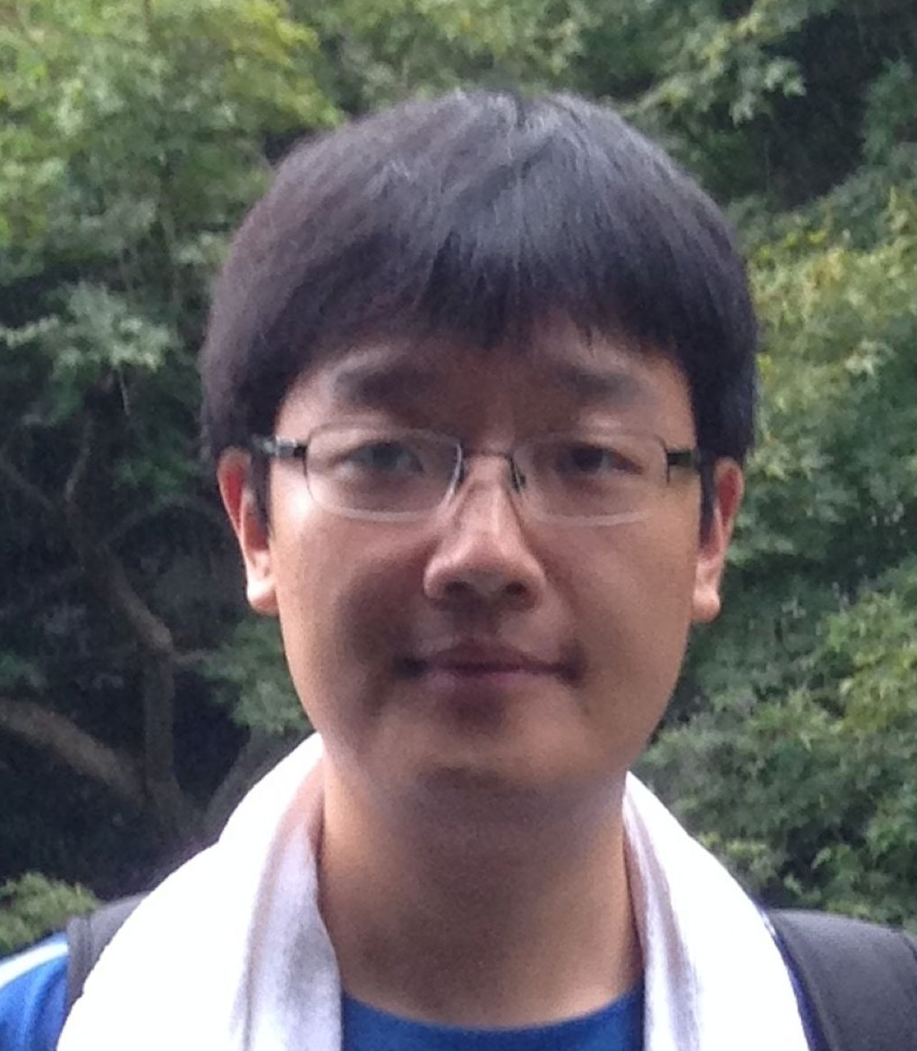

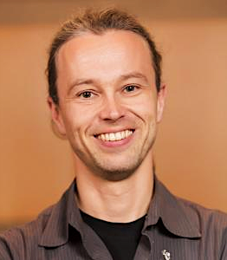
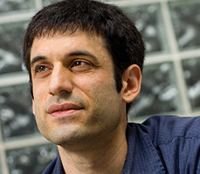
Collaborators
Yanan
Sui
Vincent
Zhuang
Josef
Broder
Joel
Burdick
Thorsten
Joachims
Bobby
Kleinberg

Slide 3
Outline
Brief Overview of Multi-Armed Bandits
  Sequential Experimental Design
Dueling Bandits
  Mathematical properties
  Connections to other problems
Recent Results & Ongoing Research

Slide 4
Multi-Armed Bandit Problem
(stochastic version)
K actions (aka arms or bandits)
Each action has an average reward: μ_{k}
  Unknown to us
  Assume WLOG that u₁ is largest
For t = 1…T
  Algorithm chooses action a(t)
  Receives random reward y(t)
    Expectation μ_{a(t)}
    Goal: minimize Tu₁ – (μ_{a(1)} + μ_{a(2)} + … + μ_{a(T)})
Algorithm only receives
feedback on chosen action
“Regret”
If we had perfect information to start
Expected Reward of Algorithm

Slide 5

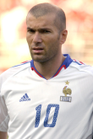

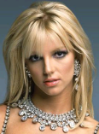

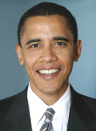
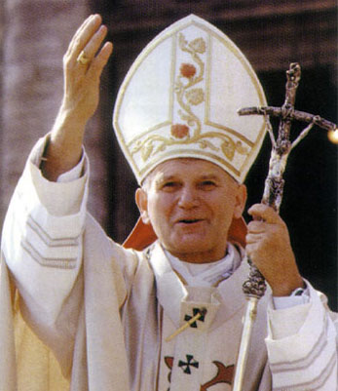

Example:
Interactive Personalization
Sports
-- | -- | -- | -- | --
0 | 0 | 0 | 1 | 0
: 0
Average Likes
# Shown

Slide 6

Example:
Interactive Personalization
Sports
-- | -- | -- | 0 | --
0 | 0 | 0 | 1 | 0
: 0
Average Likes
# Shown

Slide 7
Example:
Interactive Personalization
Politics
-- | -- | -- | 0 | --
0 | 0 | 1 | 1 | 0
: 0
Average Likes
# Shown

Slide 8

Example:
Interactive Personalization
Politics
-- | -- | 1 | 0 | --
0 | 0 | 1 | 1 | 0
: 1
Average Likes
# Shown

Slide 9
Example:
Interactive Personalization
World
-- | -- | 1 | 0 | --
0 | 0 | 1 | 1 | 1
: 1
Average Likes
# Shown

Slide 10
Example:
Interactive Personalization
World
-- | -- | 1 | 0 | 0
0 | 0 | 1 | 1 | 1
: 1
Average Likes
# Shown

Slide 11
Example:
Interactive Personalization
Economy
-- | -- | 1 | 0 | 0
0 | 1 | 1 | 1 | 1
: 1
Average Likes
# Shown

Slide 12
Example:
Interactive Personalization
Economy
…
-- | 1 | 1 | 0 | 0
0 | 1 | 1 | 1 | 1
: 2
Average Likes
# Shown

Slide 13
What Should Algorithm Recommend?
Exploit:
Explore:
Best:
Economy
Celebrity
Politics
How to Optimally Balance Explore/Exploit Tradeoff?
Characterized by the Multi-Armed Bandit Problem
-- | 0.44 | 0.4 | 0.33 | 0.2
0 | 25 | 10 | 15 | 20
: 24
Average Likes
# Shown

Slide 14
( )
( )
( )
…
( )
( )
( )
…
Time Horizon
Regret:
Opportunity cost of not knowing preferences
“no-regret” if R(T)/T ➔ 0
  Efficiency measured by convergence rate

Slide 15
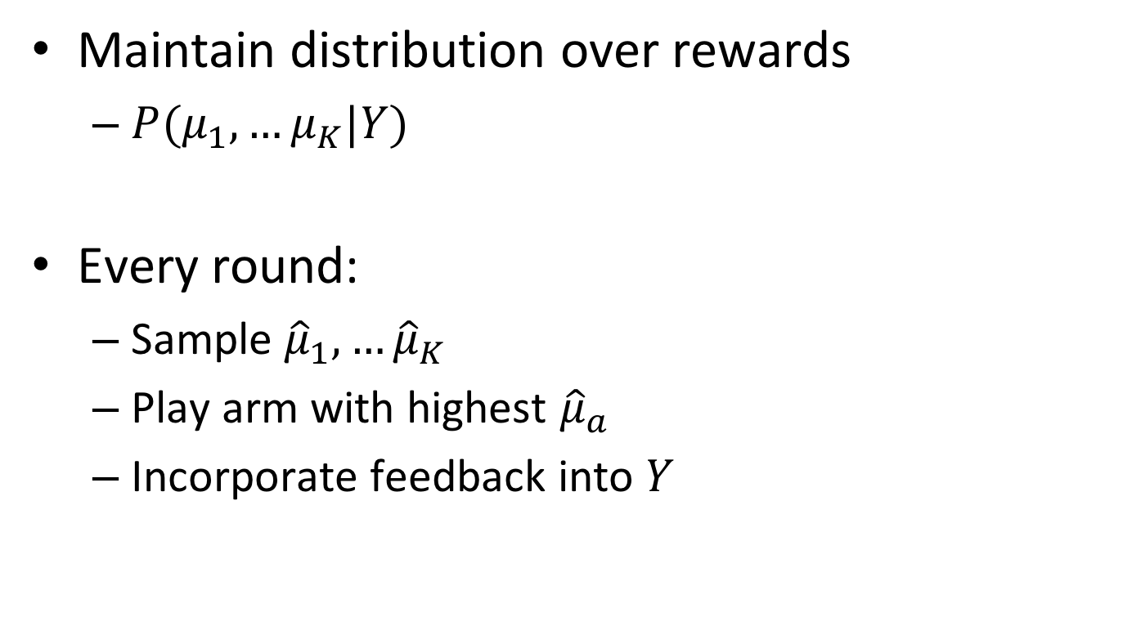
Thompson Sampling
Maintain distribution over rewards
  $P(μ_{1},…μ_{K}|Y)$
Every round:
  Sample ${\hat{μ}}_{1},…{\hat{μ}}_{K}$
  Play arm with highest ${\hat{μ}}_{a}$
  Incorporate feedback into $Y$

Slide 16
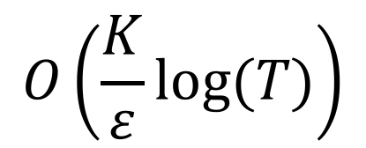
Incentivizing Exploration
# Arms
$$O\left(\frac{K}{ε}log⁡(T)\right)$$
Regret Bound:
Time horizon
Gap between best & 2nd best
[Agrawal & Goyal; COLT 2012]
Images from Chu-Cheng Hsieh

Slide 17
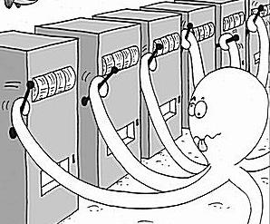
The Motivating Problem
Slot Machine = One-Armed Bandit
Goal: Minimize regret From pulling suboptimal arms
Each Arm Has
Different Payoff
Image source: http://research.microsoft.com/en-us/projects/bandits/

Slide 18

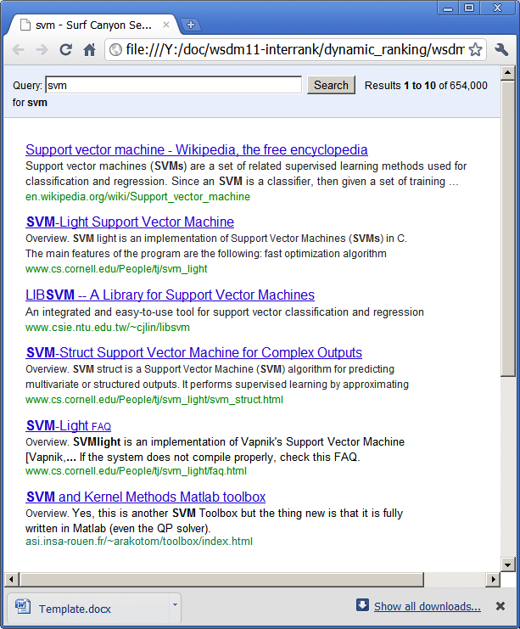



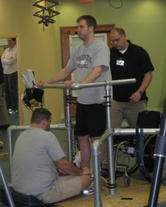
Many Applications
Online Advertising
Search Engines
Recommender Systems
Sequential Experimental Design
Personalized Clinical
Treatment

Slide 19
What if Rewards aren’t Directly Measureable?

Slide 20

Evaluating using Click Data
Interpretation 1:
Result #2 is good.
(Absolute)
Click
Interpretation 2:
Result #2 is better
than Result #1.
(Relative / Preference)

Slide 21
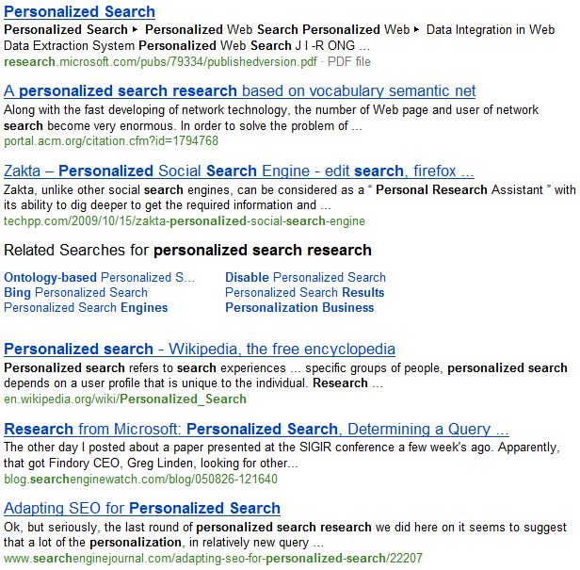
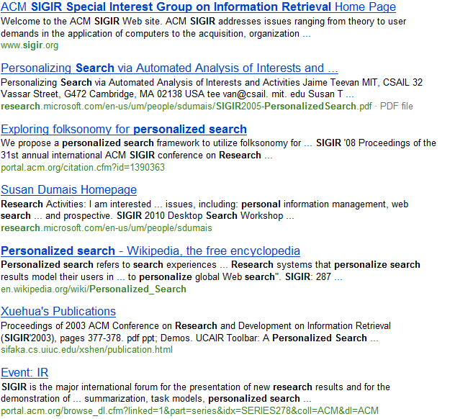
Evaluating using Click Data
Retrieval Function A
Retrieval Function B
Click
Which is better?
Click
Click

Slide 22
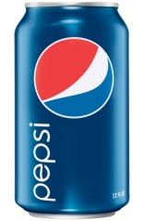
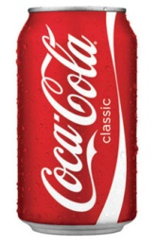
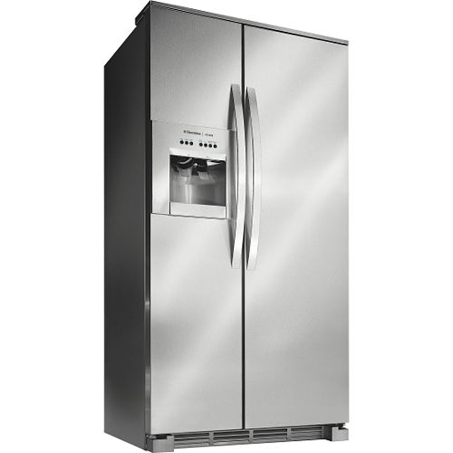
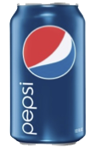
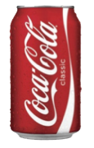
Analogy to Sensory Testing
(Hypothetical) taste experiment: vs
  Natural usage context
Experiment 1: Absolute Metrics
Very Thirsty!
3 cans
3 cans
2 cans
1 can
5 cans
3 cans
Total: 8 cans
Total: 9 cans

Slide 23
Analogy to Sensory Testing
(Hypothetical) taste experiment: vs
  Natural usage context
Experiment 1: Relative Metrics
2 - 1
3 - 0
2 - 0
1 - 0
4 - 1
2 - 1
All 6 prefer Pepsi

Slide 24
Interleaving (Taste Test in Search)
Ranking A
Napa Valley – The authority for lodging...
www.napavalley.com
Napa Valley Wineries - Plan your wine...
www.napavalley.com/wineries
Napa Valley College
www.napavalley.edu/homex.asp
4. Been There | Tips | Napa Valley
www.ivebeenthere.co.uk/tips/16681
5. Napa Valley Wineries and Wine
www.napavintners.com
6. Napa Country, California – Wikipedia
en.wikipedia.org/wiki/Napa_Valley
Ranking B
1. Napa Country, California – Wikipedia
en.wikipedia.org/wiki/Napa_Valley
2. Napa Valley – The authority for lodging...
www.napavalley.com
3. Napa: The Story of an American Eden...
books.google.co.uk/books?isbn=...
4. Napa Valley Hotels – Bed and Breakfast...
www.napalinks.com
5. NapaValley.org
www.napavalley.org
6. The Napa Valley Marathon
www.napavalleymarathon.org
Presented Ranking
Napa Valley – The authority for lodging...
www.napavalley.com
2. Napa Country, California – Wikipedia
en.wikipedia.org/wiki/Napa_Valley
3. Napa: The Story of an American Eden...
books.google.co.uk/books?isbn=...
Napa Valley Wineries – Plan your wine...
www.napavalley.com/wineries
5. Napa Valley Hotels – Bed and Breakfast...
www.napalinks.com
Napa Balley College
www.napavalley.edu/homex.asp
7 NapaValley.org
www.napavalley.org
A
B
[Radlinski et al. 2008]
Notes:
Slide credit Filip Radlinski

Slide 25
Interleaving (Taste Test in Search)
Ranking A
Napa Valley – The authority for lodging...
www.napavalley.com
Napa Valley Wineries - Plan your wine...
www.napavalley.com/wineries
Napa Valley College
www.napavalley.edu/homex.asp
4. Been There | Tips | Napa Valley
www.ivebeenthere.co.uk/tips/16681
5. Napa Valley Wineries and Wine
www.napavintners.com
6. Napa Country, California – Wikipedia
en.wikipedia.org/wiki/Napa_Valley
Ranking B
1. Napa Country, California – Wikipedia
en.wikipedia.org/wiki/Napa_Valley
2. Napa Valley – The authority for lodging...
www.napavalley.com
3. Napa: The Story of an American Eden...
books.google.co.uk/books?isbn=...
4. Napa Valley Hotels – Bed and Breakfast...
www.napalinks.com
5. NapaValley.org
www.napavalley.org
6. The Napa Valley Marathon
www.napavalleymarathon.org
Presented Ranking
Napa Valley – The authority for lodging...
www.napavalley.com
2. Napa Country, California – Wikipedia
en.wikipedia.org/wiki/Napa_Valley
3. Napa: The Story of an American Eden...
books.google.co.uk/books?isbn=...
Napa Valley Wineries – Plan your wine...
www.napavalley.com/wineries
5. Napa Valley Hotels – Bed and Breakfast...
www.napalinks.com
Napa Valley College
www.napavalley.edu/homex.asp
7 NapaValley.org
www.napavalley.org
Click
B wins!
Click
[Radlinski et al. 2008]
Notes:
Slide credit Filip Radlinski

Slide 26
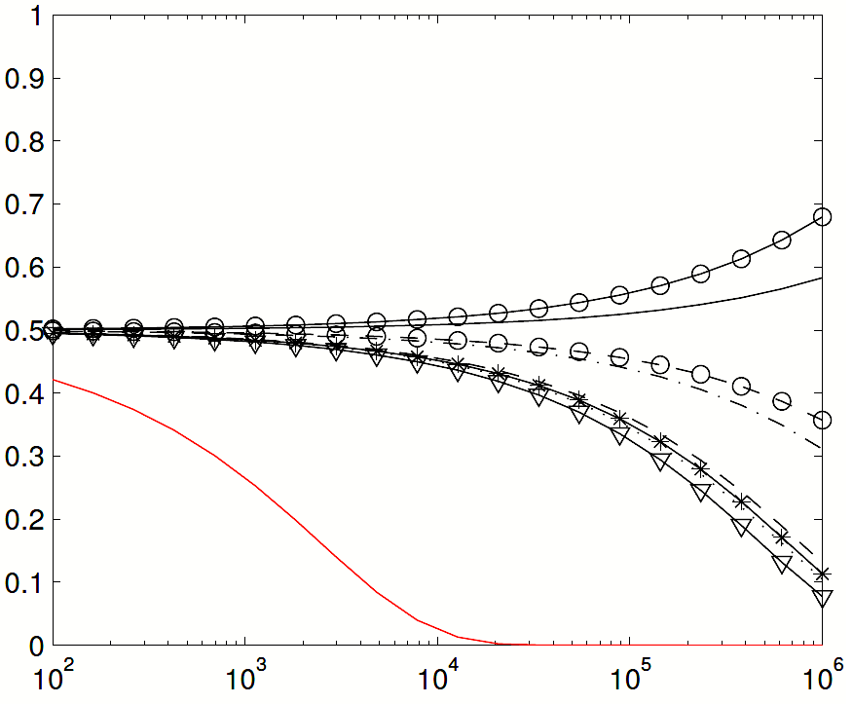
Deployment on Yahoo! Search Engine
Comparing Two Ranking Functions
B E T T E R
Disagreement Probability
Absolute Metrics
E.g., #Clicks@1,
Total #Clicks, etc.
100x
Each ranking function
receives 50% traffic
Interleaving
# Queries
Interleaving is more sensitive and more reliable
  [Chapelle, Joachims, Radlinski & Yue, TOIS 2012]

Slide 27
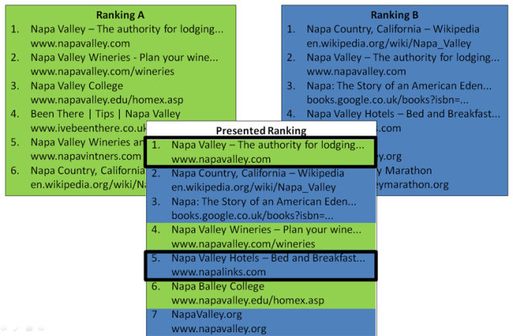
Interleave A vs B
…
 | Left wins | Right wins
A vs B | 0 | 1
A vs C | 0 | 0
B vs C | 0 | 0

Slide 28
Interleave A vs C
…
 | Left wins | Right wins
A vs B | 0 | 1
A vs C | 0 | 1
B vs C | 0 | 0

Slide 29
Interleave B vs C
…
 | Left wins | Right wins
A vs B | 0 | 1
A vs C | 0 | 1
B vs C | 0 | 1

Slide 30


Dueling Bandits Problem
Goal: Maximize total user utility
Exploit: run C
(interleave C with itself)
Explore: interleave A vs B
Best: A
(interleave A with itself)
How to interact optimally?
Interleave A vs C
…
 | Left wins | Right wins
A vs B | 0 | 1
A vs C | 1 | 1
B vs C | 0 | 1

Slide 31
Example Pairwise Preferences
 | A | B | C | D | E | F
A | 0 | 0.03 | 0.04 | 0.06 | 0.10 | 0.11
B | -0.03 | 0 | 0.03 | 0.05 | 0.08 | 0.11
C | -0.04 | -0.03 | 0 | 0.04 | 0.07 | 0.09
D | -0.06 | -0.05 | -0.04 | 0 | 0.05 | 0.07
E | -0.10 | -0.08 | -0.07 | -0.05 | 0 | 0.03
F | -0.11 | -0.11 | -0.09 | -0.07 | -0.03 | 0
Utility function may not exist
How to define regret?
Values are Pr(row > col) – 0.5

Slide 32
Example Pairwise Preferences
 | A | B | C | D | E | F
A | 0 | 0.03 | 0.04 | 0.06 | 0.10 | 0.11
B | -0.03 | 0 | 0.03 | 0.05 | 0.08 | 0.11
C | -0.04 | -0.03 | 0 | 0.04 | 0.07 | 0.09
D | -0.06 | -0.05 | -0.04 | 0 | 0.05 | 0.07
E | -0.10 | -0.08 | -0.07 | -0.05 | 0 | 0.03
F | -0.11 | -0.11 | -0.09 | -0.07 | -0.03 | 0
Utility function may not exist
How to define regret?
Compare against best bandit!
Values are Pr(row > col) – 0.5

Slide 33
Dueling Bandits Problem
(with Josef Broder, Robert Kleinberg and Thorsten Joachims)
K bandits b₁, …, b_{K}
Each iteration: compare (duel) two bandits
  Observe (noisy) outcome
Cost function (regret):
(b_{t}, b_{t}’) are the two bandits chosen
b* is the overall best one
(How much human user preferred b* over chosen bandits)
Requires Dueling Mechanism
[Yue, Broder, Kleinberg & Joachims, COLT 2009]

Slide 34
Dueling Bandits Problem
 | A | B | C | D | E | F
A | 0 | 0.03 | 0.04 | 0.06 | 0.10 | 0.11
B | -0.03 | 0 | 0.03 | 0.05 | 0.08 | 0.11
C | -0.04 | -0.03 | 0 | 0.04 | 0.07 | 0.09
D | -0.06 | -0.05 | -0.04 | 0 | 0.05 | 0.07
E | -0.10 | -0.08 | -0.07 | -0.05 | 0 | 0.03
F | -0.11 | -0.11 | -0.09 | -0.07 | -0.03 | 0
Observe
Compare E & F:
P(A > E) = 0.60
P(A > F) = 0.61
Incurred Regret = 0.21
Values are Pr(row > col) – 0.5

Slide 35
Dueling Bandits Problem
 | A | B | C | D | E | F
A | 0 | 0.03 | 0.04 | 0.06 | 0.10 | 0.11
B | -0.03 | 0 | 0.03 | 0.05 | 0.08 | 0.11
C | -0.04 | -0.03 | 0 | 0.04 | 0.07 | 0.09
D | -0.06 | -0.05 | -0.04 | 0 | 0.05 | 0.07
E | -0.10 | -0.08 | -0.07 | -0.05 | 0 | 0.03
F | -0.11 | -0.11 | -0.09 | -0.07 | -0.03 | 0
Observe
Compare B & C:
P(A > B) = 0.53
P(A > C) = 0.54
Incurred Regret = 0.07
Values are Pr(row > col) – 0.5

Slide 36
Dueling Bandits Problem
 | A | B | C | D | E | F
A | 0 | 0.03 | 0.04 | 0.06 | 0.10 | 0.11
B | -0.03 | 0 | 0.03 | 0.05 | 0.08 | 0.11
C | -0.04 | -0.03 | 0 | 0.04 | 0.07 | 0.09
D | -0.06 | -0.05 | -0.04 | 0 | 0.05 | 0.07
E | -0.10 | -0.08 | -0.07 | -0.05 | 0 | 0.03
F | -0.11 | -0.11 | -0.09 | -0.07 | -0.03 | 0
Observe
Compare A & A:
P(A > A) = 0.50
P(A > A) = 0.50
Incurred Regret = 0.00
Values are Pr(row > col) – 0.5

Slide 37
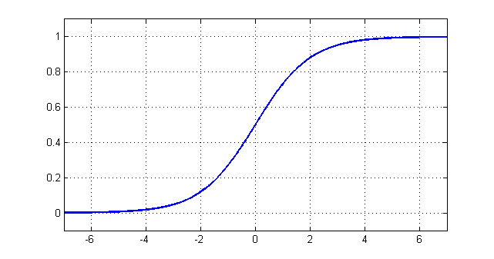
Basic Modeling Assumptions
P(b_{i} > b_{j}) = ½ + ε_{ij} (distinguishability)
Strong Stochastic Transitivity
  For three bandits b_{i} > b_{j} > b_{k} :
  Monotonicity property
Stochastic Triangle Inequality
  For three bandits b_{i} > b_{j} > b_{k} :
  Diminishing returns property
Satisfied by many standard models
  E.g., Logistic / Bradley-Terry
[Yue, Broder, Kleinberg & Joachims, COLT 2009]

Slide 38
Strong Stochastic Transitivity
(Assumes Condorcet Winner)
Monotonic
 | A | B | C | D | E | F
A | 0 | 0.03 | 0.04 | 0.06 | 0.10 | 0.11
B | -0.03 | 0 | 0.03 | 0.05 | 0.08 | 0.11
C | -0.04 | -0.03 | 0 | 0.04 | 0.07 | 0.09
D | -0.06 | -0.05 | -0.04 | 0 | 0.05 | 0.07
E | -0.10 | -0.08 | -0.07 | -0.05 | 0 | 0.03
F | -0.11 | -0.11 | -0.09 | -0.07 | -0.03 | 0
Monotonic
Values are Pr(row > col) – 0.5

Slide 39
Stochastic Triangle Inequality
(Assumes Condorcet Winner)
Red ≤ Blue + Green
 | A | B | C | D | E | F
A | 0 | 0.03 | 0.04 | 0.06 | 0.10 | 0.11
B | -0.03 | 0 | 0.03 | 0.05 | 0.08 | 0.11
C | -0.04 | -0.03 | 0 | 0.04 | 0.07 | 0.09
D | -0.06 | -0.05 | -0.04 | 0 | 0.05 | 0.07
E | -0.10 | -0.08 | -0.07 | -0.05 | 0 | 0.03
F | -0.11 | -0.11 | -0.09 | -0.07 | -0.03 | 0
Values are Pr(row > col) – 0.5

Slide 40
Stochastic Triangle Inequality
(Assumes Condorcet Winner)
Red ≤ Blue + Green
 | A | B | C | D | E | F
A | 0 | 0.03 | 0.04 | 0.06 | 0.10 | 0.11
B | -0.03 | 0 | 0.03 | 0.05 | 0.08 | 0.11
C | -0.04 | -0.03 | 0 | 0.04 | 0.07 | 0.09
D | -0.06 | -0.05 | -0.04 | 0 | 0.05 | 0.07
E | -0.10 | -0.08 | -0.07 | -0.05 | 0 | 0.03
F | -0.11 | -0.11 | -0.09 | -0.07 | -0.03 | 0
Values are Pr(row > col) – 0.5

Slide 41

Other Modeling Assumptions
Approximate Linearity
Other Solution Concepts
  Borda Winner [Jamieson et al., 2015]
  Copeland Winner [Zoghi et al., 2015]
  Von Neuman Winner [Dudik et al., 2015]
  General Tournament Solutions [Ramamohan et al., 2016]
Conditioning on Context [Dudik et al., 2015]
Adversarial Setting [Gajane et al., 2015]
Continuous Convex Setting [Yue & Joachims, 2009]
$$ε_{ik}−ε_{jk}≥γε_{ij}$$

Slide 42

Connection to Tournaments
Each pair “duels” until statistical significance
Aka Noisy Tournament
  Guarantees finding best bandit w.h.p.
  Can we use as explore algorithm?
Best!
[Feige et al., 1994]

Slide 43

Tournament is Bad
Each pair “duels” until statistical significance
Problem: two
Equally bad bandits
Analogy: Hypothetical Soccer Tournament
  A team wins when it has a 3-goal lead
  Audience prefers good teams play (regret)
  Two (nearly) equally bad teams will play for a long time

Slide 44
Many Algorithms
Interleaved Filter [Yue et al., 2009]
Beat the Mean [Yue & Joachims, 2011]
SAVAGE [Urvoy et al., 2013]
RMED [Komiyama et al., 2015]
RUCB [Zoghi et al., 2014; 2015]
Double Thompson Sampling [Wu & Liu, 2016]
Sparring [Ailon et al., 2014]
SelfSparring (under review)
…

Slide 45
Many Algorithms
Interleaved Filter [Yue et al., 2009]
Beat the Mean [Yue & Joachims, 2011]
SAVAGE [Urvoy et al., 2013]
RMED [Komiyama et al., 2015]
RUCB [Zoghi et al., 2014; 2015]
Double Thompson Sampling [Wu & Liu, 2016]
Sparring [Ailon et al., 2014]
SelfSparring (under review)
…
+ Extensions!

Slide 46
Outline
Algorithms & Theory
  Sparring [Ailon et al., 2014]
  Challenges in Regret Analysis
  SelfSparring
  Theoretical Results
Experiments
Extensions
  Application to Personalized Clinical Treatment

Slide 47
Dueling Bandits ≈ Zero-Sum Game
Player 1
 | A | B | C | D | E | F
A | 0 | 0.03 | 0.04 | 0.06 | 0.10 | 0.11
B | -0.03 | 0 | 0.03 | 0.05 | 0.08 | 0.11
C | -0.04 | -0.03 | 0 | 0.04 | 0.07 | 0.09
D | -0.06 | -0.05 | -0.04 | 0 | 0.05 | 0.07
E | -0.10 | -0.08 | -0.07 | -0.05 | 0 | 0.03
F | -0.11 | -0.11 | -0.09 | -0.07 | -0.03 | 0
Player 2
Basic Setting: Single Dominant Strategy
Regret = Opportunity Cost to Social Welfare
Values are Pr(row > col) – 0.5

Slide 48
Dueling Bandits ≈ Zero-Sum Game
Player 1
 | A | B | C | D | E | F
A | 0 | 0.03 | 0.04 | 0.06 | 0.10 | 0.11
B | -0.03 | 0 | 0.03 | 0.05 | 0.08 | 0.11
C | -0.04 | -0.03 | 0 | 0.04 | 0.07 | 0.09
D | -0.06 | -0.05 | -0.04 | 0 | 0.05 | 0.07
E | -0.10 | -0.08 | -0.07 | -0.05 | 0 | 0.03
F | -0.11 | -0.11 | -0.09 | -0.07 | -0.03 | 0
Player 2
Basic Setting: Single Dominant Strategy
Regret = Opportunity Cost to Social Welfare
Values are Pr(row > col) – 0.5

Slide 49
Dueling Bandits ≈ Zero-Sum Game
Player 1
 | A | B | C | D | E | F
A | 0 | 0.03 | 0.04 | 0.06 | 0.10 | 0.11
B | -0.03 | 0 | 0.03 | 0.05 | 0.08 | 0.11
C | -0.04 | -0.03 | 0 | 0.04 | 0.07 | 0.09
D | -0.06 | -0.05 | -0.04 | 0 | 0.05 | 0.07
E | -0.10 | -0.08 | -0.07 | -0.05 | 0 | 0.03
F | -0.11 | -0.11 | -0.09 | -0.07 | -0.03 | 0
Player 2
Basic Setting: Single Dominant Strategy
Regret = Opportunity Cost to Social Welfare
Values are Pr(row > col) – 0.5

Slide 50
Dueling Bandits ≈ Zero-Sum Game
Player 1
 | A | B | C | D | E | F
A | 0 | 0.03 | 0.04 | 0.06 | 0.10 | 0.11
B | -0.03 | 0 | 0.03 | 0.05 | 0.08 | 0.11
C | -0.04 | -0.03 | 0 | 0.04 | 0.07 | 0.09
D | -0.06 | -0.05 | -0.04 | 0 | 0.05 | 0.07
E | -0.10 | -0.08 | -0.07 | -0.05 | 0 | 0.03
F | -0.11 | -0.11 | -0.09 | -0.07 | -0.03 | 0
Player 2
Basic Setting: Single Dominant Strategy
Regret = Opportunity Cost to Social Welfare
Values are Pr(row > col) – 0.5

Slide 51
Sparring
Instantiate 2 MAB algorithms: P₁ & P₂
For t = 1, …
  P₁ chooses a₁
  P₂ chooses a₂
  Duel a₁ vs a₂
  Provide feedback
Reducing Dueling Bandits to Cardinal Bandits
Ailon, Karnin & Joachims, ICML 2014

Slide 52
Intuition
Reduction to standard MAB settings
  Each player selfishly maximizes own reward
Instantiate P₁
For t = 1, …
  P₁ chooses a₁
  Plays a₁
  Observes feedback
Instantiate P₂
For t = 1, …
  P₂ chooses a₂
  Plays a₂
  Observes feedback

Slide 53
Drifting Reward Distributions
Playing against a changing environment
  Rewards depend on other player
Players learn over time
  Environment drifts over time

Slide 54
Stochastic vs Adversarial
Stochastic: Reward of each arm fixed
  E.g., UCB1 & Thompson Sampling
  No guarantees within Sparring
Adversarial: Rewards chosen adversarially
  E.g., EXP3
  Very slow in practice
Not fully adversarial!

Slide 55
Thought Experiment
If one player has converged
  Then other player is playing stochastic MAB!
Both players implement learning algorithms
  Slowly drifts to fixed distribution

Slide 56

Chicken & Egg Problem
If one player has converged
  Can prove other player is converging
If one player is converging
  Can prove other is converging (slower)

Slide 57
SelfSparring
Yanan
Sui
Instantiate 1 MAB algorithm P
For t = 1, …
  P chooses a₁
  P chooses a₂
  Duel a₁ vs a₂
  Provide feedback
Probabilistic Bandit Algorithm
(Thompson Sampling)
Multi-dueling Bandits with Dependent Arms
Sui, Zhuang, Yue & Burdick, (under review)

Slide 58

Theoretical Insights
(SelfSparring)
Each player playing against itself
  Can tightly couple convergence of both players
Once converged enough
  Can prove optimal regret bound (asymptotic)
# Arms
$$O\left(\frac{K}{ε}log⁡(T)\right)$$
Time horizon
Gap between
best & 2nd best
Multi-dueling Bandits with Dependent Arms
Sui, Zhuang, Yue & Burdick, (under review)

Slide 59
SelfSparring
Optimal asymptotic regret bound
Performs very well in practice
Easily extendable to new settings

Slide 60
Basic Experiments
B E T T E R
SelfSparring
Multi-dueling Bandits with Dependent Arms
Sui, Zhuang, Yue & Burdick, (under review)

Slide 61
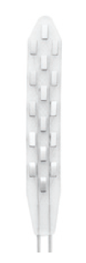
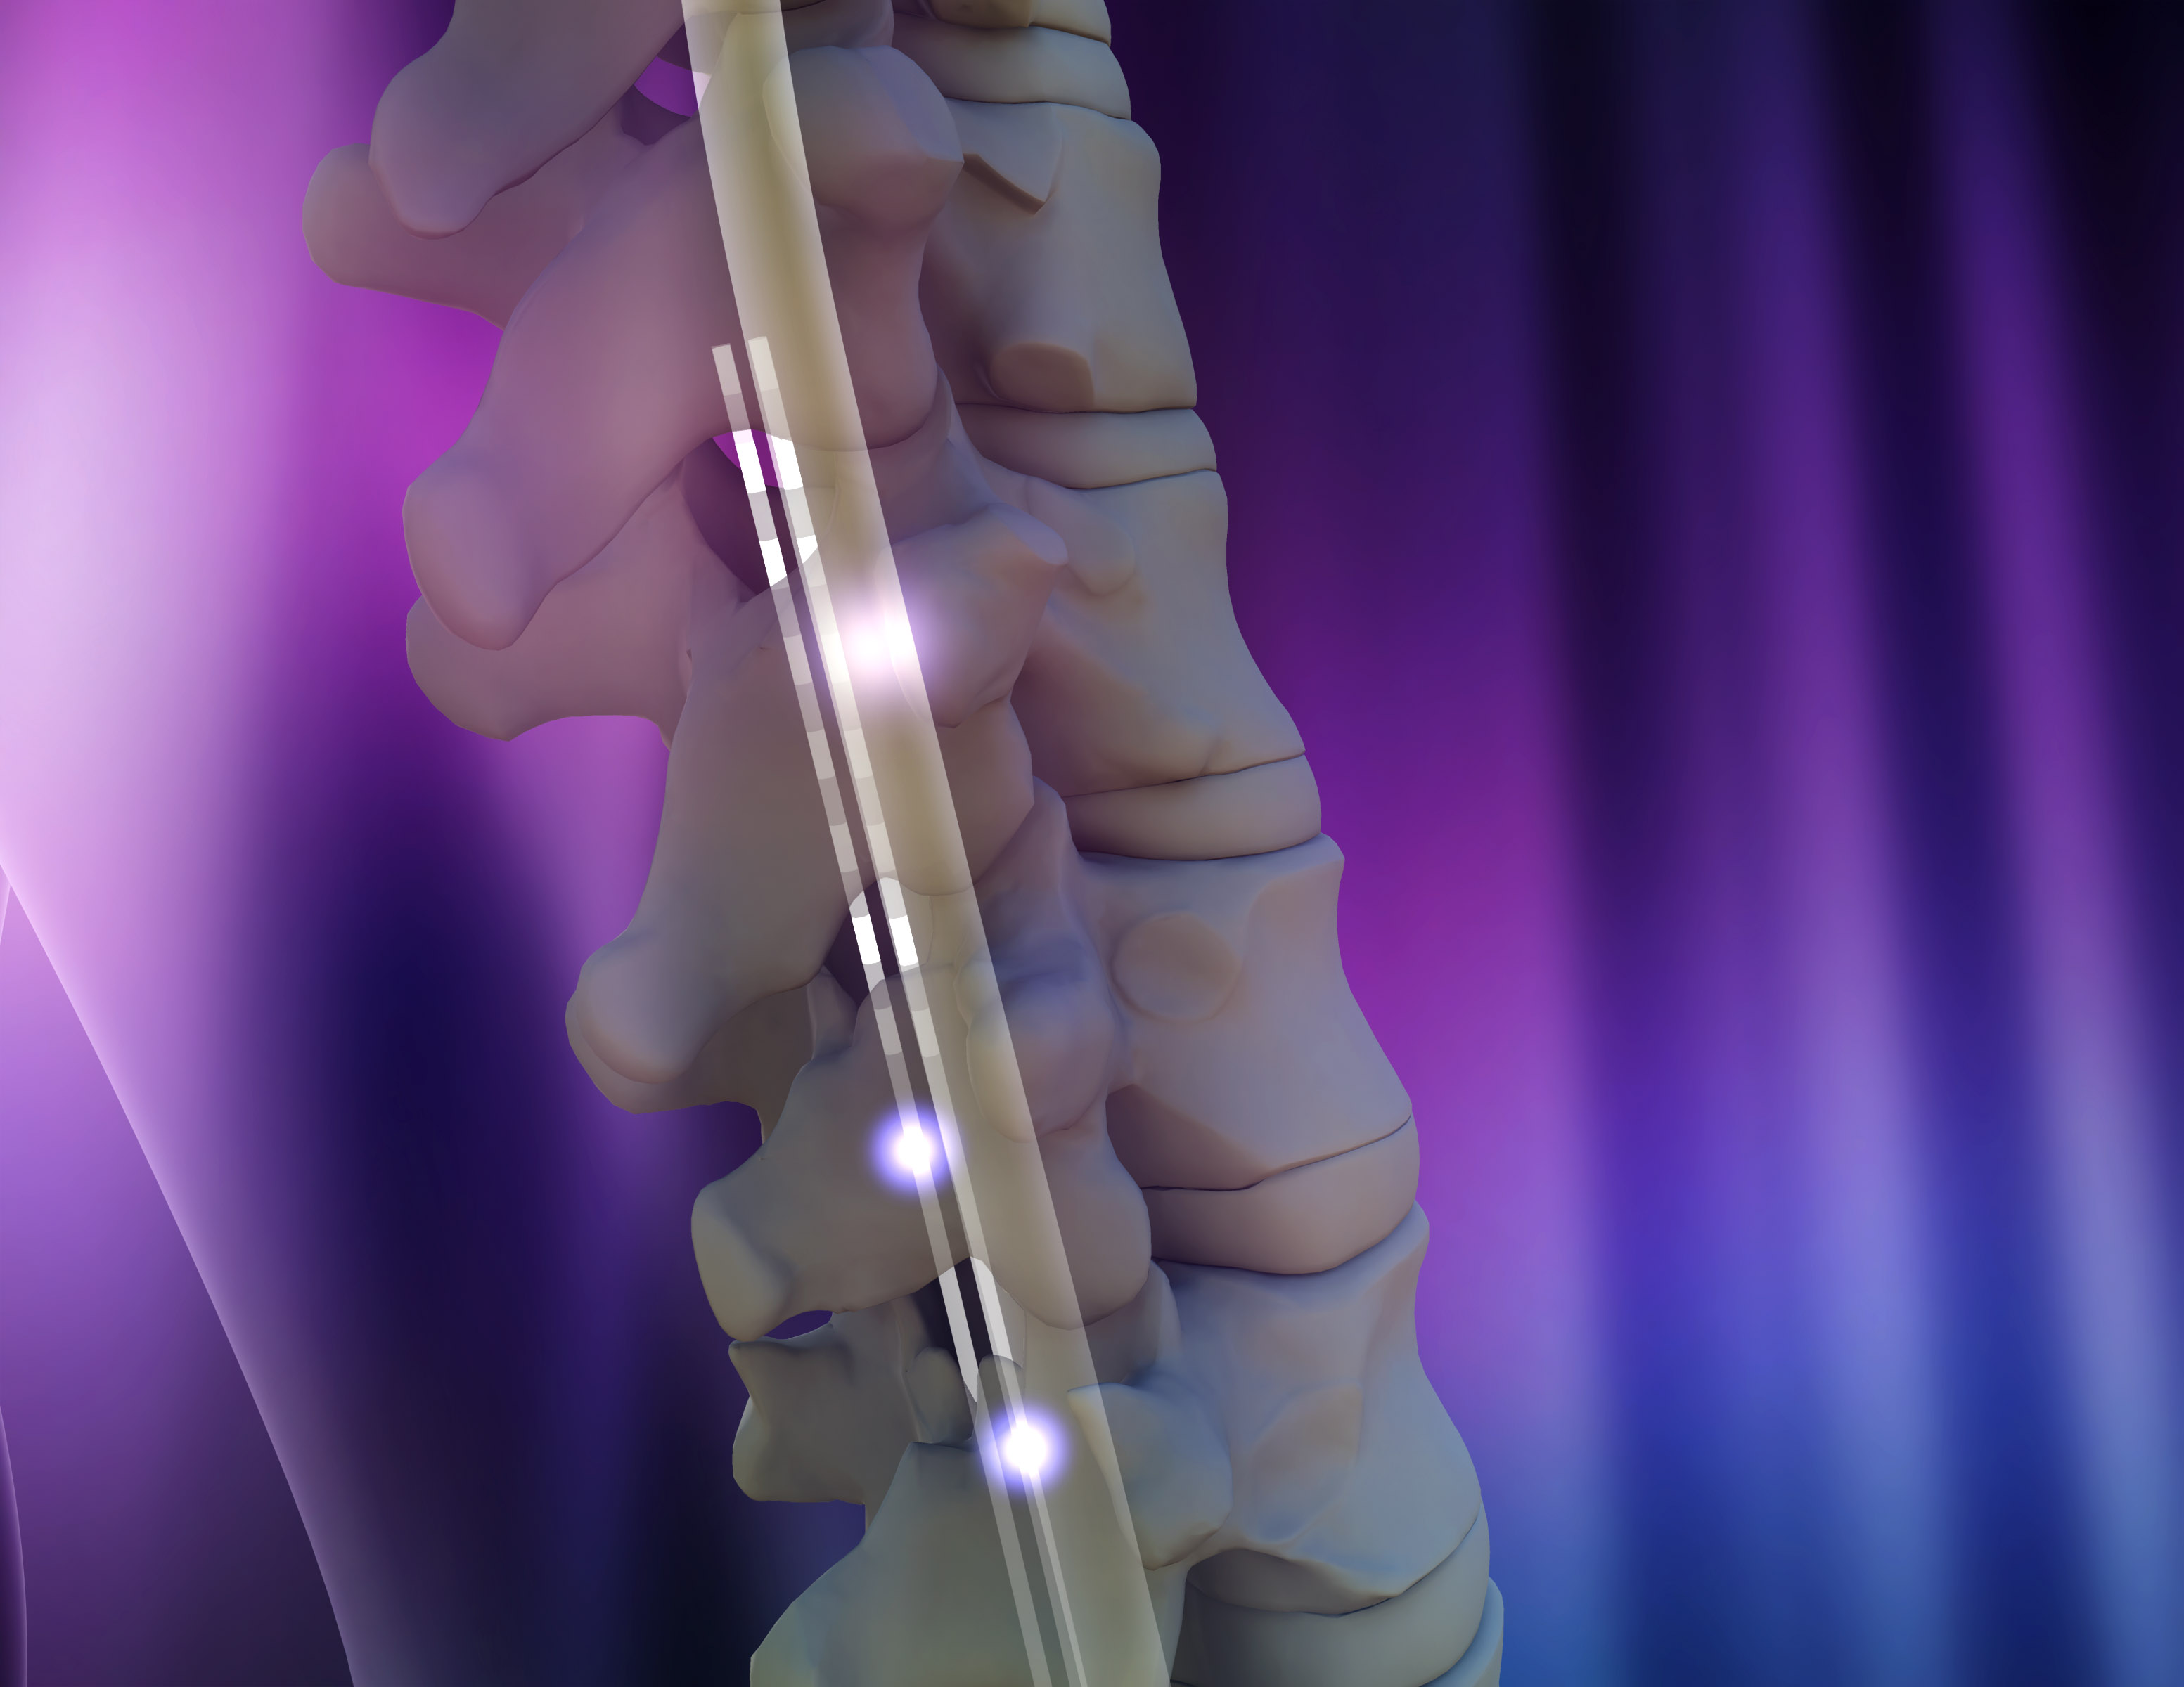
Ongoing Work:
Personalized Clinical Treatment
10 mm
Image source:
williamcapicottomd.com
Yanan Sui
49 mm
Medtronic human array
Each patient is unique
10⁶ possible configurations!
SCI Patient

Slide 62

Challenges
Many arms
  K = 10⁶
Duel more than 2 arms
$$O\left(\frac{K}{ε}log⁡(T)\right)$$
 | 5 |  |  |  | 5 |  |  |  | 5 |  |  |  | 5 |  |  |  | 5
0 |  | 11 |  | 0 |  | 11 |  | 0 |  | 11 |  | 0 |  | 11 |  | 0 |  | 11
 | 6 |  |  |  | 6 |  |  |  | 6 |  |  |  | 6 |  |  |  | 6
1 |  | 12 |  | 1 |  | 12 |  | 1 |  | 12 |  | 1 |  | 12 |  | 1 |  | 12
 | 7 |  |  |  | 7 |  |  |  | 7 |  |  |  | 7 |  |  |  | 7
2 |  | 13 |  | 2 |  | 13 |  | 2 |  | 13 |  | 2 |  | 13 |  | 2 |  | 13
 | 8 |  |  |  | 8 |  |  |  | 8 |  |  |  | 8 |  |  |  | 8
3 |  | 14 |  | 3 |  | 14 |  | 3 |  | 14 |  | 3 |  | 14 |  | 3 |  | 14
 | 9 |  |  |  | 9 |  |  |  | 9 |  |  |  | 9 |  |  |  | 9
4 |  | 15 |  | 4 |  | 15 |  | 4 |  | 15 |  | 4 |  | 15 |  | 4 |  | 15
 | 10 |  |  |  | 10 |  |  |  | 10 |  |  |  | 10 |  |  |  | 10

Slide 63
Challenges
Many arms
  K = 10⁶
Duel more than 2 arms
$$O\left(\frac{K}{ε}log⁡(T)\right)$$
 | 5 |  |  |  | 5 |  |  |  | 5 |  |  |  | 5 |  |  |  | 5
0 |  | 11 |  | 0 |  | 11 |  | 0 |  | 11 |  | 0 |  | 11 |  | 0 |  | 11
 | 6 |  |  |  | 6 |  |  |  | 6 |  |  |  | 6 |  |  |  | 6
1 |  | 12 |  | 1 |  | 12 |  | 1 |  | 12 |  | 1 |  | 12 |  | 1 |  | 12
 | 7 |  |  |  | 7 |  |  |  | 7 |  |  |  | 7 |  |  |  | 7
2 |  | 13 |  | 2 |  | 13 |  | 2 |  | 13 |  | 2 |  | 13 |  | 2 |  | 13
 | 8 |  |  |  | 8 |  |  |  | 8 |  |  |  | 8 |  |  |  | 8
3 |  | 14 |  | 3 |  | 14 |  | 3 |  | 14 |  | 3 |  | 14 |  | 3 |  | 14
 | 9 |  |  |  | 9 |  |  |  | 9 |  |  |  | 9 |  |  |  | 9
4 |  | 15 |  | 4 |  | 15 |  | 4 |  | 15 |  | 4 |  | 15 |  | 4 |  | 15
 | 10 |  |  |  | 10 |  |  |  | 10 |  |  |  | 10 |  |  |  | 10

Slide 64
Multi-Dueling Bandits
For t = 1, …
  Choose M arms
  Duel M arms
  Observe outcomes
All Pairs
Winner takes all
Random set of pairs
Probabilistic Multi-Leaving
Comparing Multiple Stimuli
 | 5 |  |  |  | 5 |  |  |  | 5 |  |  |  | 5 |  |  |  | 5
0 |  | 11 |  | 0 |  | 11 |  | 0 |  | 11 |  | 0 |  | 11 |  | 0 |  | 11
 | 6 |  |  |  | 6 |  |  |  | 6 |  |  |  | 6 |  |  |  | 6
1 |  | 12 |  | 1 |  | 12 |  | 1 |  | 12 |  | 1 |  | 12 |  | 1 |  | 12
 | 7 |  |  |  | 7 |  |  |  | 7 |  |  |  | 7 |  |  |  | 7
2 |  | 13 |  | 2 |  | 13 |  | 2 |  | 13 |  | 2 |  | 13 |  | 2 |  | 13
 | 8 |  |  |  | 8 |  |  |  | 8 |  |  |  | 8 |  |  |  | 8
3 |  | 14 |  | 3 |  | 14 |  | 3 |  | 14 |  | 3 |  | 14 |  | 3 |  | 14
 | 9 |  |  |  | 9 |  |  |  | 9 |  |  |  | 9 |  |  |  | 9
4 |  | 15 |  | 4 |  | 15 |  | 4 |  | 15 |  | 4 |  | 15 |  | 4 |  | 15
 | 10 |  |  |  | 10 |  |  |  | 10 |  |  |  | 10 |  |  |  | 10

Slide 65

Multi-Dueling SelfSparring
SelfSparring generalizes trivially!
  Just sample M times!
  (Sparring requires M separate bandit algorithms)
Can prove same regret bound
$$O\left(\frac{K}{ε}log⁡(T)\right)$$
Constant depends on
dueling mechanism
Multi-dueling Bandits with Dependent Arms
Sui, Zhuang, Yue & Burdick, (under review)

Slide 66
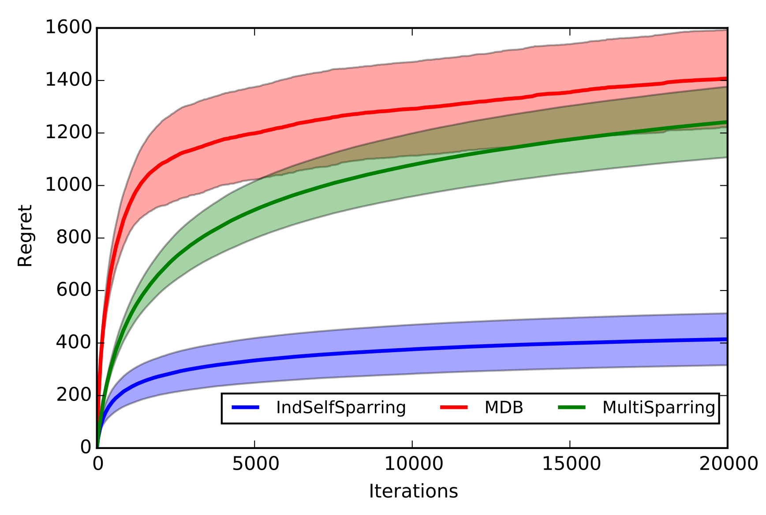
Multi-Dueling Experiments
Heuristics
B E T T E R
SelfSparring
Sparring not displayed due to very poor scaling
Most DB algorithms not applicable
Multi-dueling Bandits with Dependent Arms
Sui, Zhuang, Yue & Burdick, (under review)

Slide 67
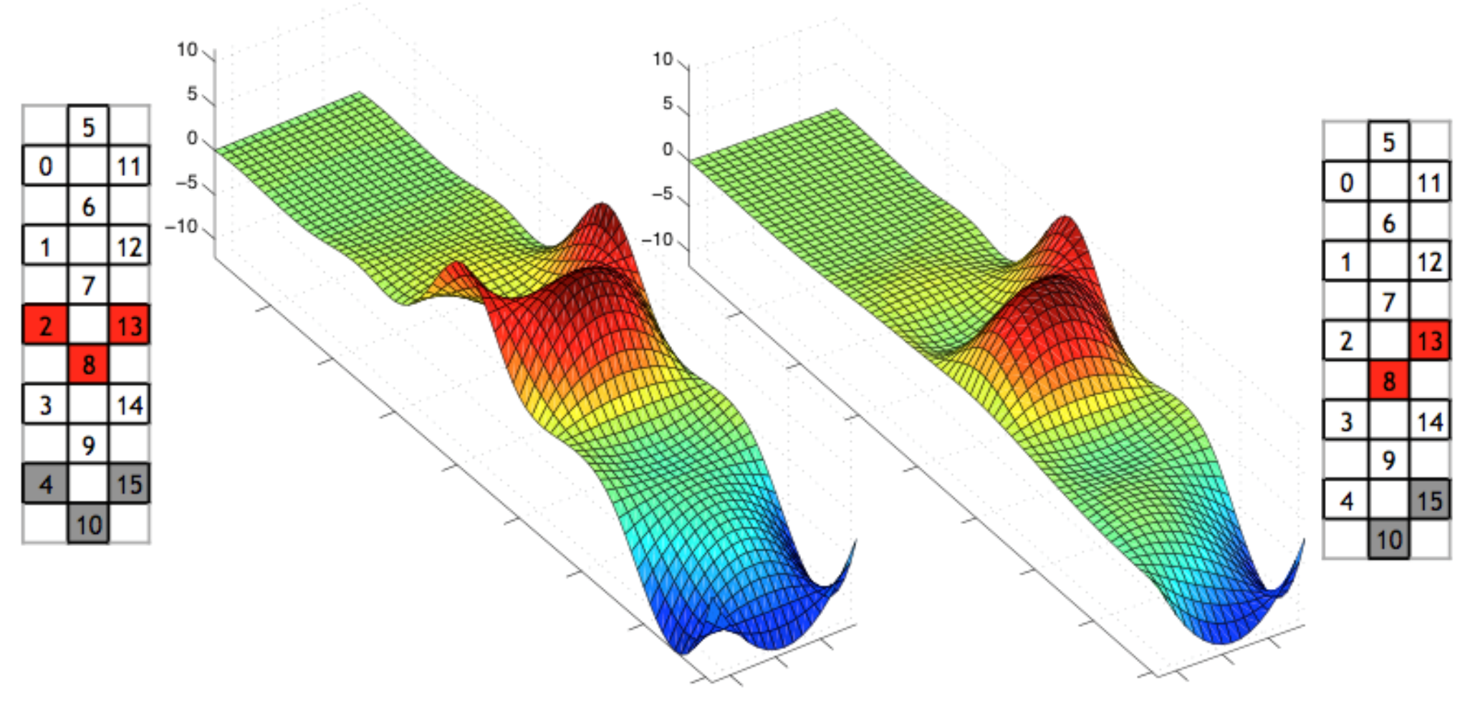
Dueling Bandits w/ Dependent Arms
Suppose K is very large (possibly infinite)
  But arms have dependency structure
  E.g., P(a>b) ≈ P(a’>b) if a similar to a’
  Measure similarity using kernel
Want convergence to depend on D
  And not K!
Dimensionality of Kernel
Multi-dueling Bandits with Dependent Arms
Sui, Zhuang, Yue & Burdick, (under review)

Slide 68
Visualizing Electrical Potentials

Slide 69
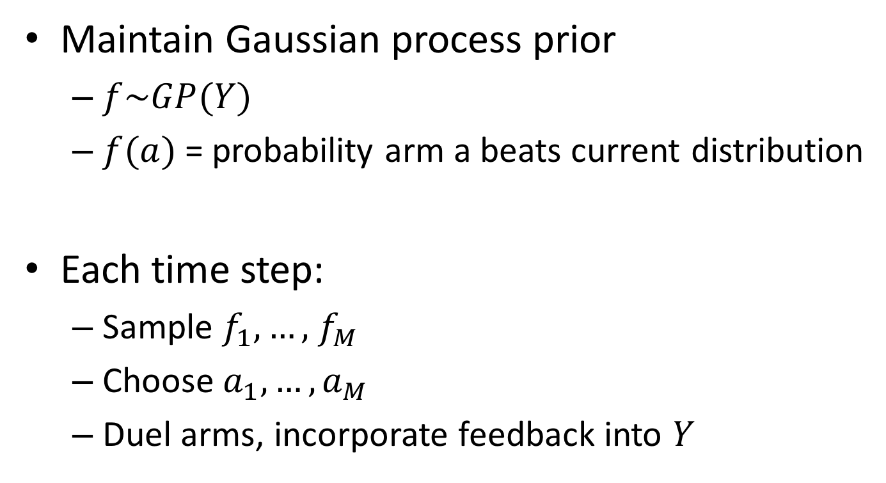
SelfSparring w/ Gaussian Processes
Maintain Gaussian process prior
  $f\sim GP(Y)$
  $f(a)$= probability arm a beats current distribution
Each time step:
  Sample $f_{1},…,$ $f_{M}$
  Choose $a_{1},…,a_{M}$
  Duel arms, incorporate feedback into $Y$

Slide 70
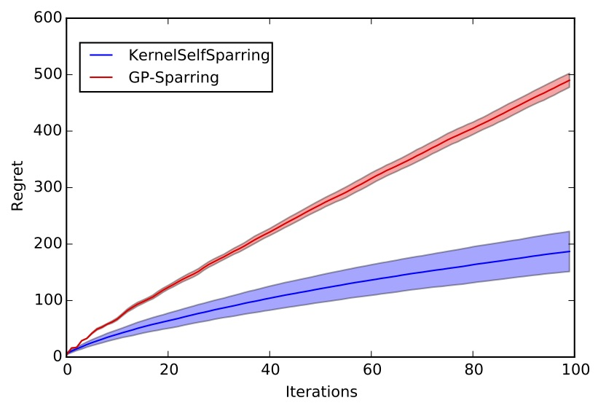
Kernel Multi-Dueling Experiments
Sparring
B E T T E R
SelfSparring
Multi-dueling Bandits with Dependent Arms
Sui, Zhuang, Yue & Burdick, (under review)

Slide 71
Back to Motivating Application
Preference Response
Apply Stimuli
Electrode Array
SCI Patient

Slide 72
Preliminary Clinical Results: Human
B E T T E R

Slide 73
Preliminary Clinical Results: DB Algorithm
B E T T E R

Slide 74
Summary: Dueling Bandits Problem
Elicits preference feedback
  Motivated by human-centric personalization
  Characterizes explore/exploit tradeoff
Ongoing research
  Personalized clinical treatment
  Dependent arms (regret bound?)
  Complex dueling mechanisms

Slide 75
The K-armed Dueling Bandits Problem, Yisong Yue, Josef Broder, Robert Kleinberg and Thorsten Joachims, COLT 2009
Interactively Optimizing Information Retrieval Systems as a Dueling Bandits Problem, Yisong Yue and Thorsten Joachims, ICML 2009
Beat the Mean Bandit, by Yisong Yue and Thorsten Joachims, ICML 2011
Large-Scale Validation and Analysis of Interleaved Search Evaluation, Olivier Chapelle, Thorsten Joachims, Filip Radlinski, Yisong Yue, TOIS 2012
Probabilistic Multileave for Online Retrieval Evaluation, Anne Schuth et al., SIGIR 2015
Reusing Historical Interaction Data for Faster Online Learning to Rank for IR, Katja Hofmann, Anne Schuth, Shimon Whiteson, and Maarten de Rijke, WSDM 2013
Generic Exploration and K-armed Voting Bandits, Tanguy Urvoy, Fabrice Clerot, Raphael Feraud and Sami Naamane, ICML 2013
Reducing Dueling Bandits to Cardinal Bandits, Nir Ailon, Zohar Karnin and Thorsten Joachims, ICML 2014
Relative Upper Confidence Bound for the K-armed Dueling Bandit Problem, Masrour Zoghi, Shimon Whiteson, Remi Munos and Maarten de Rijke, ICML 2014
Clinical Online Recommendation with Subgroup Rank Feedback, Yanan Sui and Joel Burdick, RecSys 2014
Sparse Dueling Bandits, Kevin Jamieson, Sumeet Katariya, Atul Deshpande and Robert Nowak, AISTATS 2015
Contextual Dueling Bandits, Miro Dudik, Robert Schapire and Alex Slivkins, COLT 2015
A Relative Exponential Weighing Algorithm for Adversarial Utility-based Dueling Bandits, Pratik Gajane, Tanguy Urvoy and Fabrice Clerot, ICML 2015
Copeland Dueling Bandits, Masrour Zoghi, Zohar Karnin, Shimon Whiteson and Maarten de Rijke, NIPS 2015
Online Rank Elicitation for Plackett-Luce: A Dueling Bandits Approach, Balazs Szorenyi, Robert Busa-Fekete, Adil Paul and Eyke Hullermeier, NIPS 2015
Copeland Dueling Bandit Problem: Regret Lower Bound, Optimal Algorithm, and Computationally Efficient Algorithm, Junpei Komiyama, Junya Honda, Hiroshi Nakagawa, ICML 2016
Dueling Bandits: Beyond Condorcet Winners to General Tournament Solutions, Siddartha Ramamohan, Arun Rajkumar, Shivani Agarwal, NIPS 2016
Double Thompson Sampling for Dueling Bandits, Huasen Wu, Xin Liu, NIPS 2016
Dueling Bandits: Beyond Condorcet Winners to General Tournament Solutions, Siddartha Ramamohan, Arun Rajkumar, Shivani Agrawal, NIPS 2016
Multi-dueling Bandits with Dependent Arms, Yanan Sui, Vincent Zhuang, Yisong Yue, Joel Burdick, (under review)

